Slide 1
Tech-Focused Publishing on Hacker News

Slide 2
Introduction
MightyHive clients are looking to establish partnerships with tech-focused publishers on Hacker News
Hacker News is a social news website focusing on computer science and entrepreneurship
It is run by Paul Graham's investment fund and startup incubator, Y Combinator
Data is from 2016
MightyHive can analyze this data to recommend the perfect publishers for your partnership

Slide 3
Approach
Using Google’s BigQuery platform, load data from Hacker News’s full public dataset
Select all relevant columns for querying
Title
Author
Score
Descendants
Timestamp
Text
Sort data by keywords and year
Limit responses with low scores, taking only scores higher than 25

Slide 4
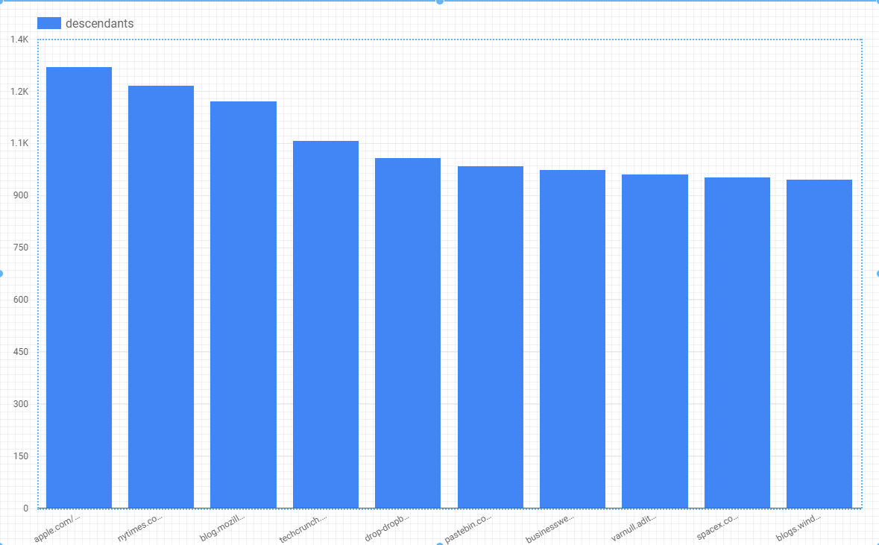
Top 10 URLs
This chart lists the top 10 URLs that have the highest number of stories
These include Apple, NYTimes.com, Mozilla, Techcrunch, Dropbox, Pastebin, Businessweek, Spacex and Windows

Slide 5
Term Frequency
Now for the fun stuff: we can start to look for stories in our data.
First, we’ll look at the most frequent words in the story or comment text
words occurring more than 15 times
Stories filtered by the keyword “tech”
We’ll only look at data from 2016
We’ll only look at stories with a score of 15 or higher

Slide 6
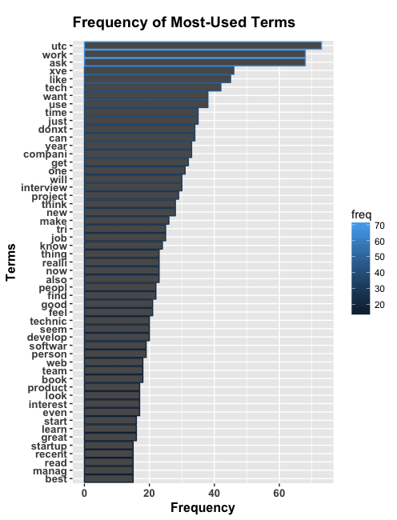
Term Frequency
Frequently used keywords in Hacker News’ 2016 top rated stories , include
Work
Tech
Companies
Interview
Project
Job
Technical
Develop
Software
Web
Product
startup

Slide 7
Top Stories
Highly scored stories from 2016 include
“What is your favorite YouTube channel for developers?
“Pick startups for YC to fund”
“What are the best personal project websites you’ve seen?”

Slide 8
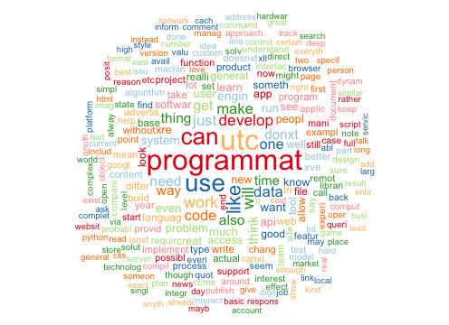
Word Cloud
To better visualize term frequency, we can look at a wordcloud. There are 601 stories from 2017 that contain the word “programmatic” in the story text.

Slide 9
Conclusion + Recommendations
Hacker News’s readers favor stories that help them reach their professional potential
They’re interested in what’s new and emerging in tech
They’re eager to learn new skills
They get their news from Apple, the New York Times, Techcrunch, Mozilla, MSN and Businessweek
These would all be great publishers to partner with
In addition, we recommend publishing on Youtube and LinkedIn
These out-of-the-box platforms fall in line with Hacker News’s commenters interest in learning new skills, self-sufficency and professional development.

